Slide 1
Business Intelligence Concepts, Tools, and Applications
Week 2: Business Intelligence Concepts and Platform Capabilities
Lesson 2: BI Platform Capabilities

Slide 2
BI Platform Capabilities
Learning objectives
Identify the main components of BI platforms capabilities
Understand the competitive landscape of BI Platforms
Notes:
BI that includes effective data warehouse and also a reactive component capable of monitoring the time-critical operational processes to allow tactical and operational decision-makers to tune their actions according to the company strategy.
BI results from in-depth analysis of detailed business data, including database and application technologies, as well as analysis practices.
Some have widen the definition of BI as technically much broader tools, that includes potentially encompassing knowledge management, enterprise resource planning, decision support systems and data mining.
Business Intelligence Platforms Modern Business Intelligence platform should provide an end-to-end infrastructure, solutions and technologies that support following issues: information integration master data management data warehousing BI tools repository of best practices and business models Among the many solutions available on the market we might pay attention to the following solution providers:
- Microsoft - Sybase - IBM - QlikTech - SAS

Slide 3



















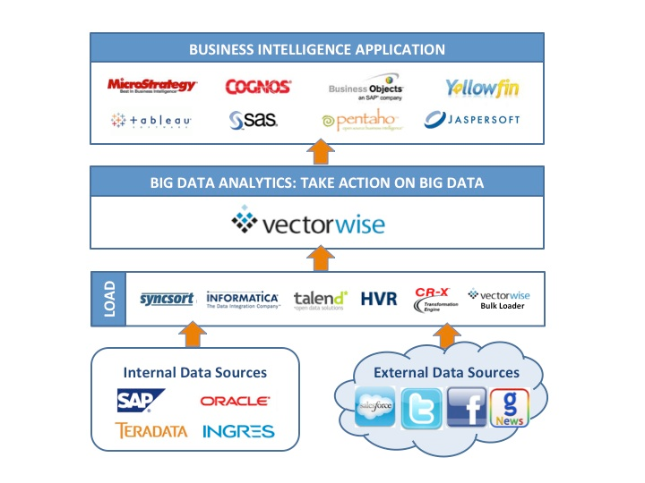





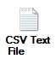








BI Platform is the Key Component of Business Analytic Applications
Analytic Applications
Customer Analysis
Customer Segmentation
Customer Profitability
Cross-sell / Up-sell
Supply Chain Management
Inventory Analysis
Fulfillment Analysis
Distribution Cost Analysis
Financial Reporting Analysis
P&L Reporting
Profitability Analysis
Financial Compliance Analysis
Product Management
Product Performance Analysis
Market Basket Analysis
Category Management
Vendor Performance Analysis
Service Level Agreement
Chargeback Analysis
Relative Sales Analysis
Risk Analysis
Risk Management
Portfolio Risk Analysis
Fraud Detection
Operations Analysis
Productivity Reporting
HR Reporting
Web Commerce Analysis
Business Intelligence Applications
Business Intelligence Platform
Data Mining & Predictive Analysis
OLAP Analysis
Data Discovery
Dashboards & Scorecards
Enterprise
Reporting
Transaction Services
Mobile Apps & Alerting
MapReduce Databases
Columnar Databases
Relational Databases
Multi-dimensional Databases
User & Departmental Data
&
Exadata
HANA
Notes:
Source: this slide is from MicroStrategy
A BI system is composed of several key components. The BI platform sits between business users you see at the top of this slide who consume the information, and all of the data sources your see at the bottom. The role of the BI platform is to interpret and harmonize all of the complex data across all of the different databases so that users and IT personnel can design reports and interact with data without requiring that they have any knowledge of the underlying technical complexities and inconsistencies that might exist in the databases.
The BI platform provides a user interface to business people with which they can interact with their company’s data in any of 7 different ways – which we call the 7 Styles of BI. The seven styles of BI are listed in the diagram and include: Reporting, Dashboards, OLAP Analysis, Advanced or Ad-hoc Analysis, and Pro-active Alerting. Many BI tools support one or two of these styles of BI within the same architecture, but with the MicroStrategy architecture, you can get all 5 Styles of BI within the exact same user interface and all built on the exact same building blocks (called metadata).
And at the right you see that the real value of a BI platform is that it allows companies to create and deploy very many BI applications composed of reports, dashboards, and other analytic workflow… some of which are created by IT professionals, some are created by analysts, but ideally, the majority are created by average business people in the normal process of doing their various jobs.
MicroStrategy presents its solution at a Platform-as-a-Service (PaaS). It is offered either on premise or in the cloud. Cloud platform services enable subscribers to build and deploy any BI application with complete customization and control, database, and ETL infrastructure.

Slide 4

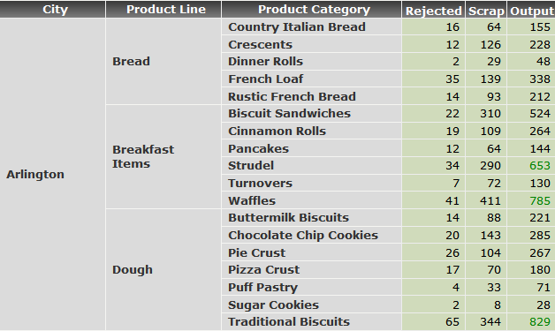
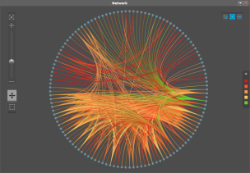
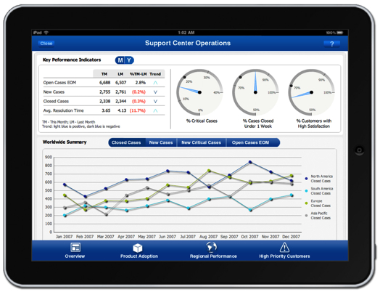
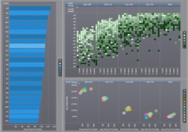
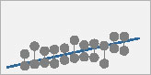
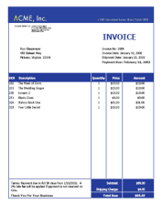
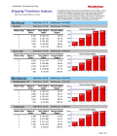
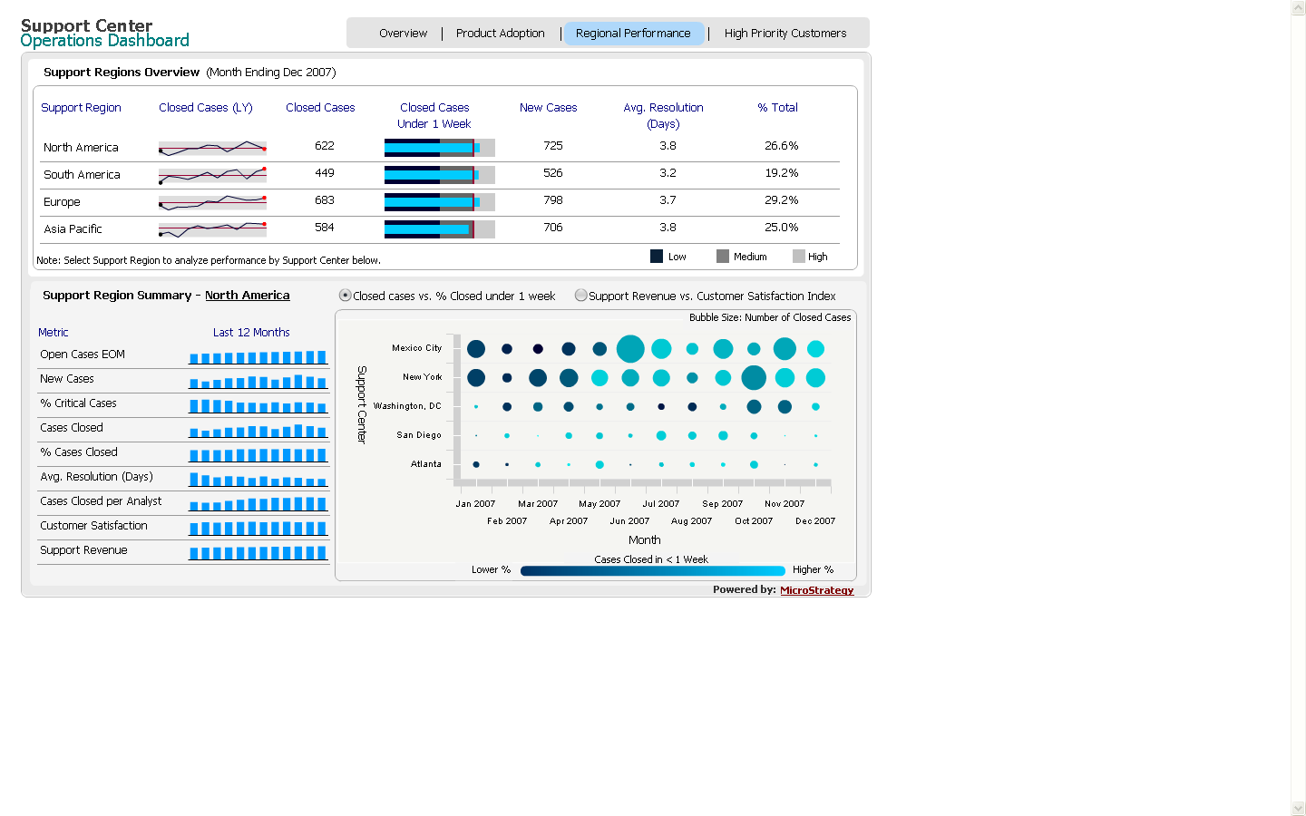
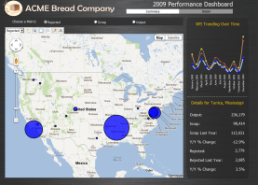
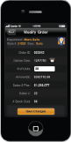


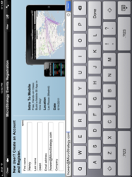
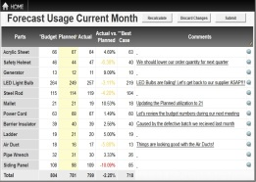

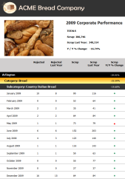



The Full Spectrum of Business Intelligence in One Seamlessly Integrated Platform
Predictive Analytics
OLAP Analysis
ANALYZE
Data Discovery
Enterprise Reports
MONITOR
Dashboards
Alerts
ACT
Transactions
Notes:
Source this slide is from MicroStrategy
The BI system should allow you to analyze, monitor and act on the information it presents to you. A significant technology that has become a key player in descriptive analytic area is data discovery and visualization. Using the latest visualization tools in the marketplace, we can now develop powerful insights into the operations of our organization.
Traditionally, BI involves delivering the right information in the right format to the right people at the right time for more informed decision making. BI decision-support applications facilitate many activities, including: multidimensional analysis, for example, online analytical processing (OLAP); click-stream analysis; data mining; forecasting, business analysis; balanced scorecard preparation; visualization; querying; reporting and charting (including just-in-time and agent-based alerts); geospatial analysis; knowledge management; enterprise portal implementation; mining for text, content, and voice; digital dashboard access; and other cross-functional activities.

Slide 5











Predictive Analytics – Full Range Under One Roof
Climb the Analytical Maturity Model to Outsmart and Outperform Competitors
Optimization
What do we want to happen?
Predictions
What is likely to happen based on past history?
World’s most popular advanced analytics tool.
Free, open source.
Relationship Analysis
What factors influence activity or behavior?
Benchmarking
Analytical Maturity
How are we doing versus comparables?
Trend Analysis
What direction are we headed in?
Data Summarization
More
What is happening in the aggregate?
Industry’s most powerful SQL Engine and 300+ native analytical functions
Specialty Tools
Notes:
Source: this slide is from MicroStrategy
See Sharda, R. Delen, D. and Turban, E. (2015), Business Intelligence and Analytics: Systems for Decision Support, 10 ED, Chapter 1.

Slide 6
OLAP Analysis
Enables users to gain insight into multi-dimensional data cube structure through fast, consistent, and interactive access.
Commonly used OLAP operations include
Slice and Dice
Drill down/ Roll up
Pivot / Rotate
Notes:
OLAP for Ad hoc query and reporting

Slide 7

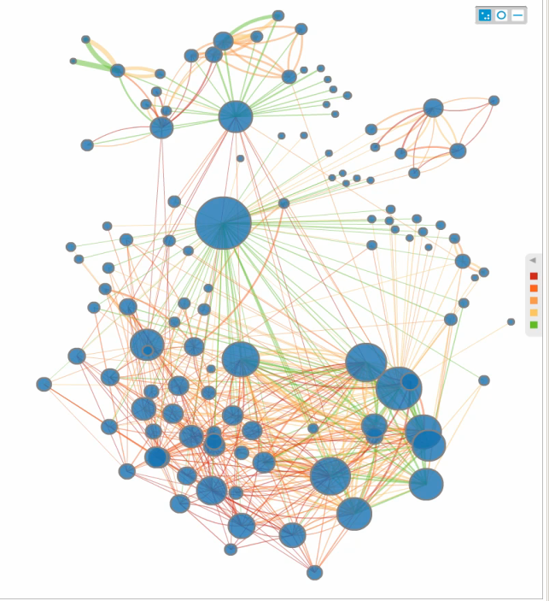
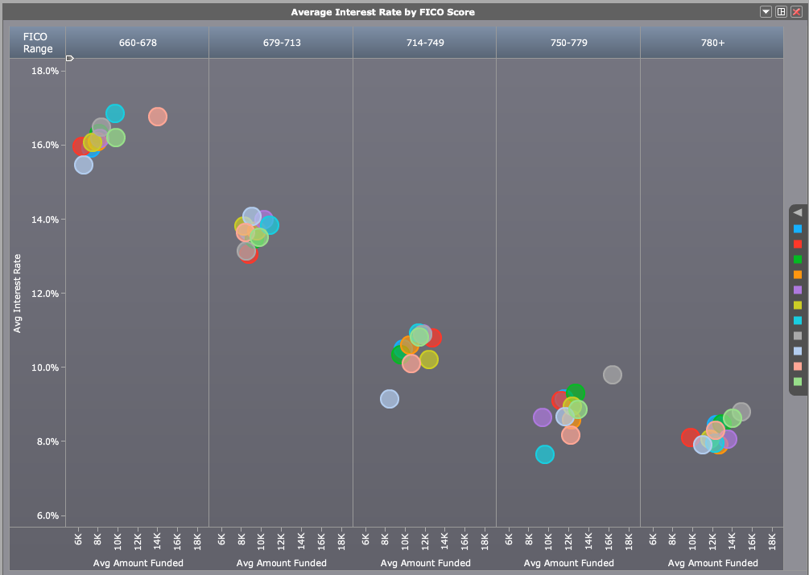
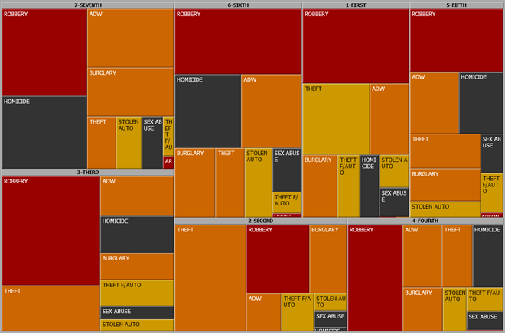
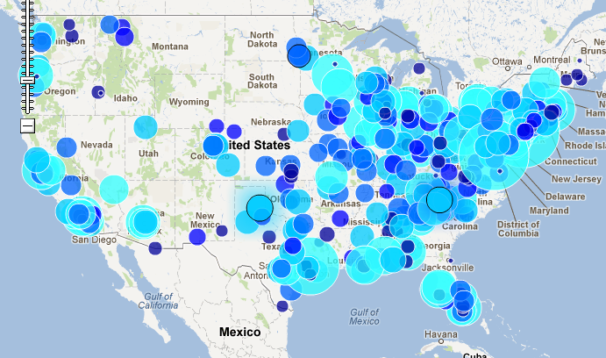
Data Discovery and Visualization Give Meaning to Otherwise Raw, Hard to Understand Data
Experiment with insightful visualizations to find patterns, trends, and relationships
Notes:
Source: this slide is from MicroStrategy
Free-Form Interactive Exploration: Enables the exploration of data via the manipulation of chart images, with the color, brightness, size, shape and motion of visual objects representing aspects of the dataset being analyzed. This includes an array of visualization options that go beyond those of pie, bar and line charts, including heat and tree maps, geographic maps, scatter plots and other special-purpose visuals. These tools enable users to analyze the data by interacting directly with a visual representation of it.

Slide 8
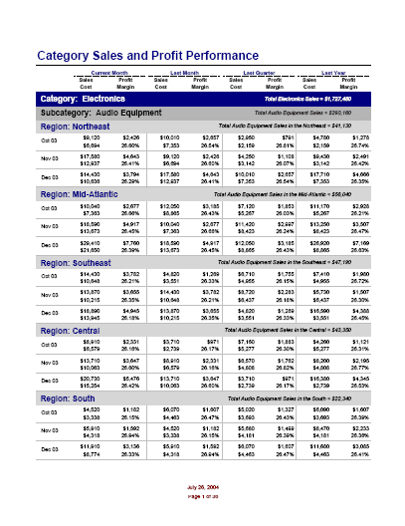
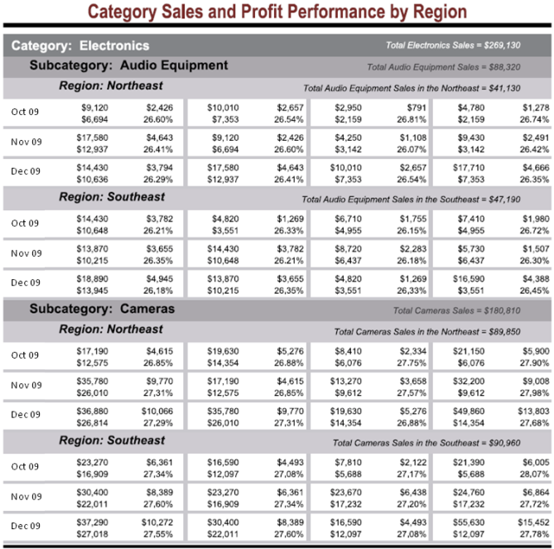
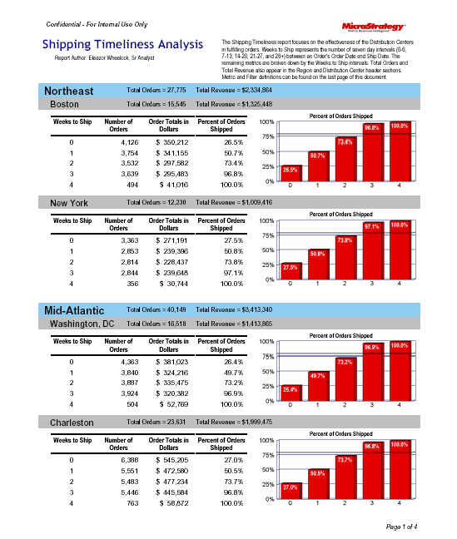

Enterprise Reporting: Delivering the Complete Range
Print-perfect Operational Reports
Via Web and Print
Easy Navigation Through Hundreds of Report Pages
Parameter Prompting Lets Users Specify Report Content
Pixel-perfect Business Reports
Created by Business Users, not IT
Integrated Tables and Graphs
Powerful Reports for Presentation or Publication
Page-perfect Invoices and Statements
On-line Billing Applications
Statements
Other Page Forms
Notes:
Source: this slide is from MicroStrategy
BI platforms need to Provides the ability to create highly formatted, print-ready and interactive reports, with or without parameters. Business reporting and visual analytics (a collection of tools for manipulating, mining, and analyzing the data in the data warehouse.
Enterprise reports are the very detailed reports that are the mainstream of reporting applications today. These highly structured, densely populated, multi-page reports are designed to convey large amounts of operational performance data. These reports are often organized hierarchically and may use banding to make them more readable.
The need to be Print-perfect so business people can take them to meetings. They need to be pixel-perfect so any format and be achieved as is especially the case with business reports. And they need to be page-perfect so that they are ready for high production printing such as with bills and statements.
Managed Metric Reports
MicroStrategy customers are also now beginning to distribute specialized reports call “managed metrics” reports. They are like dashboards, but with greater emphasis on comprehensive lists of metrics that let diverse people monitor the metrics that matter to there own contribution to the organizational goals.

Slide 9
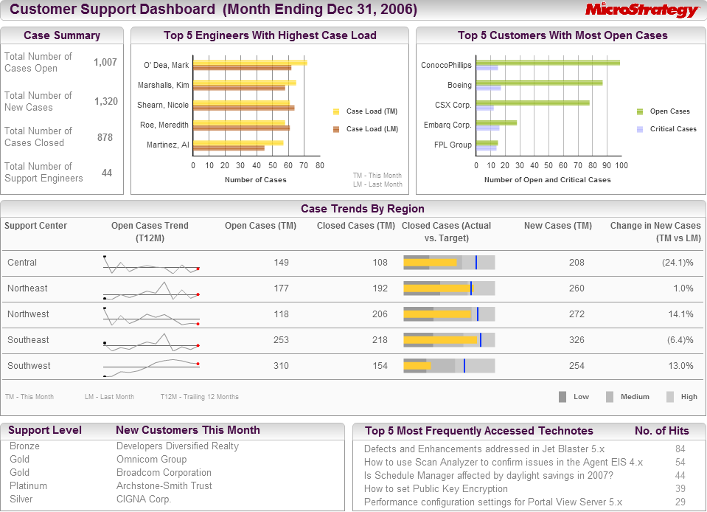
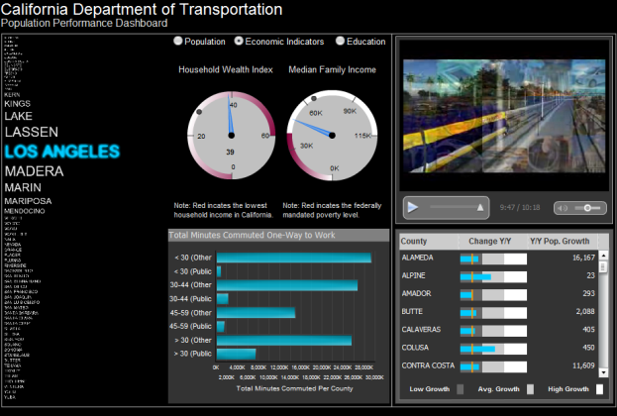
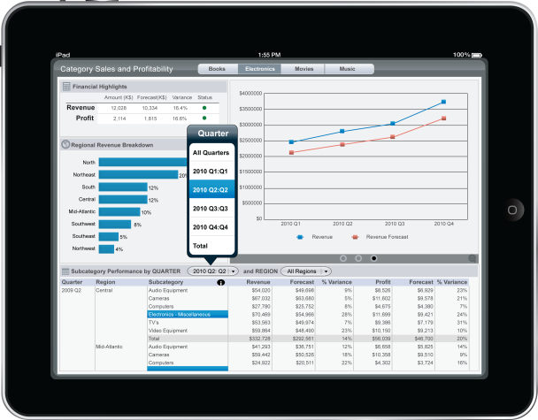
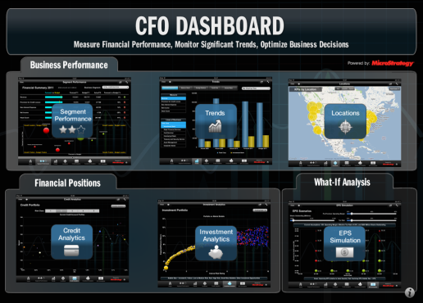
Pervasive Personalized Scorecards and Dashboards for Monitoring Performance
Dashboards
Consume Information Easily With Gauges And Dials
Integrated View of Data Across the Enterprise
Scorecards
Use Formal Scorecard Methodologies
Drill Down to View Group/ Employee Performance Scorecards
Notes:
Source: this slide is from MicroStrategy
Dashboards:. IT-authored or centrally authored dashboards are a style of reporting that graphically depicts performance measures. This includes the ability to publish multi-object, linked reports and parameters with intuitive and interactive displays; dashboards often employ visualization components such as gauges, sliders, checkboxes and maps, and are often used to show the actual value of the measure compared with a goal or target value.
Dashboards can represent operational or strategic information. The most basic business monitoring tool today are the scorecards and dashboards – typically generated for managers and executives who need an overall view of business performance.
That really takes us to a more detailed look at MicroStrategy’s capabilities for system of record business intelligence. System of record BI is all about managed delivery of data and key performance metrics at scale. It’s the idea that once you’ve created meaningful analytics, you want to be able to operationalize them, to drive them into the organization, to effectively align the organization behind those numbers, enable better decision making, and as a result, elevate performance across the organization.
Dashboards
Dashboards allow users to consume a large amount of information at a glance. Dashboards contain rich visual elements like the gauges and dials along with graphs and tables. Dashboards provide an integrated view of business performance by consolidating the data from across the enterprise
Scorecards
Scorecards often adhere to any of the major scorecard methodologies, like Balanced Scorecards, Activity Based Costing, 6 Sigma, or others.

Slide 10

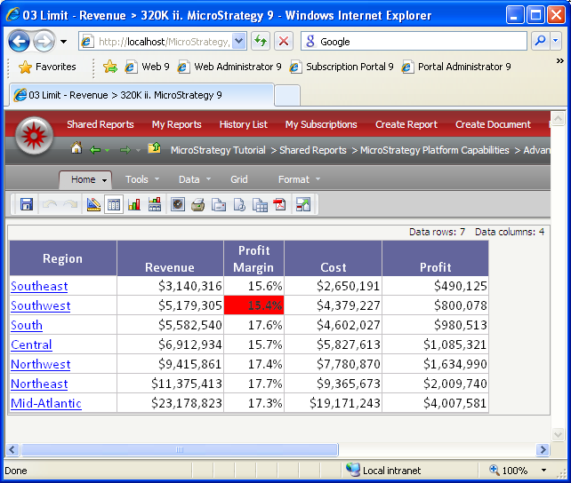


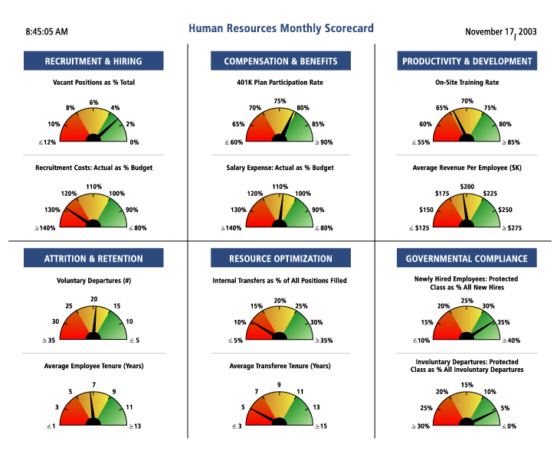
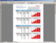
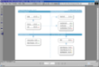






Alerting and Proactive Notification Delivers Information via E-Mail, Print, or File
High-volume, high-efficiency information distribution engine…
… that also allows delivering the right information to the right person at the right time
Time-based
BI Platform
Event-based
Reports & Dashboards
Send Now
Data-Driven Alert Trigger
Notes:
Source: this slide is from MicroStrategy
Mobile Application And Alerting. Real time BI for the real time distribution of metrics through email, messaging systems and/or interactive displays.
High volume, high efficiency engine allows to distribute the information to many people. In order to avoid spamming users with reports every day or every hour, alerts can be configured so they are notified whenever there is something that requires their immediate attention
A BI service can support two types of requirements:
The first is on behalf of a specific business activity. This could include checking a transaction for potential fraud, retrieving an individual's lifetime value metric for call routing in a customer support center, or reformatting a customer address to meet data standards. In some cases, this may be done in conjunction with traditional BI.
The second type of BI service monitors and evaluates the performance of a business process. In this case, event data is passed to the BI service from multiple points in the process workflow. These events are then consolidated and evaluated, and event metrics are produced for delivery to an operational dashboard or other business process. The event analytics can be stored in a data warehouse for subsequent use.
Event analytics determines the efficiency of a complete business process and identifies performance bottlenecks that are affecting operations. Call center performance and order processing typify these types of processes. Stream analytical applications that employ complex event processing technologies to analyze in-flight events with sub-second response times offer a more extreme example. Financial institutions and Web retailing companies use this type of high-volume processing.
With some projects, traditional BI cannot meet operational decision-making requirements. Data volumes may make it impossible to update the data warehouse and analyze information quickly enough to satisfy agility requirements. For some applications it is not practical, or even necessary, to propagate data from operational systems into a data warehouse. Sensor and hardware alerts, network interactions and messages, stock market trading operations, and RFID tag scanning, for example, could be handled by embedding the BI in the business processes and analyzing the data as it flows through these processes.

Slide 11
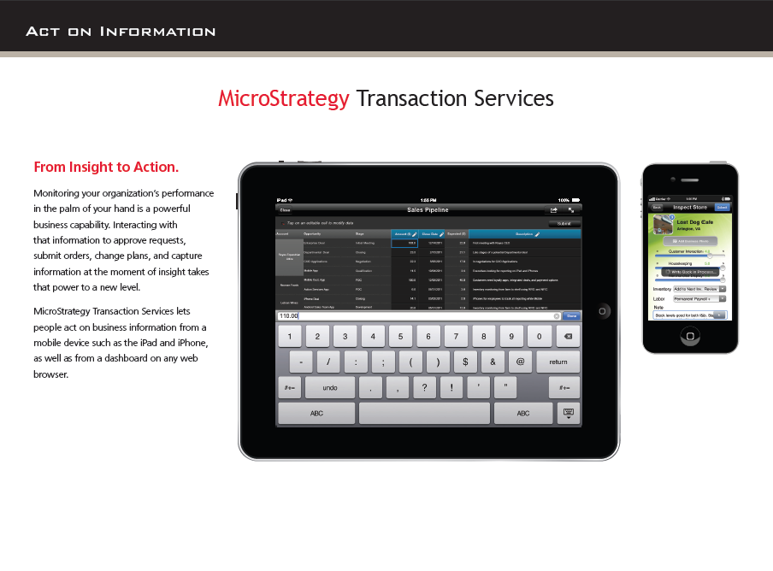
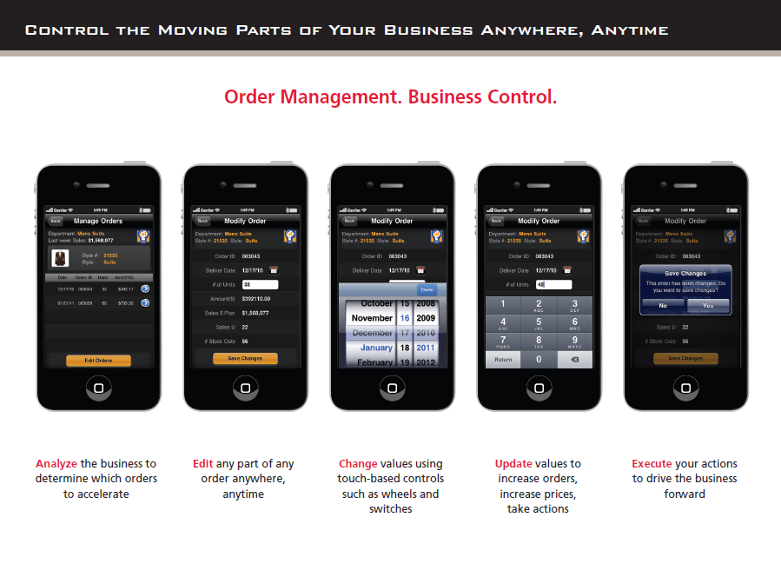

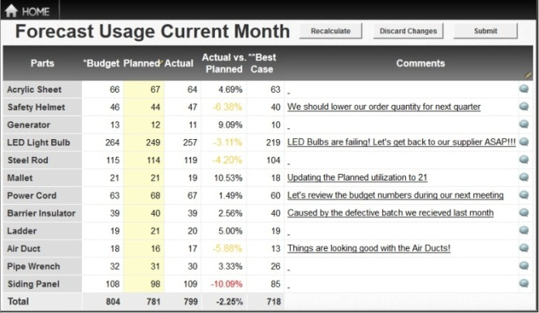
Turn Insight into Action From Any Web Browser or a Mobile Device
Extend Business Analytic Applications to Allow Real-time Decision Making
Enter sales leads
Update churn probabilities
Modify inventories
Cancel orders
Approve expense, time-off requests
Submit employee reviews
Complete surveys
And many more…
Notes:
Source: this slide is from MicroStrategy
Please note this slide is to talk about Transaction Services, not Mobile. Mobile Business Analytics Revolutionizes How, When, and Where Information Is Consumed
Mobile: Enables organizations to develop and deliver content to mobile devices in a publishing and/or interactive mode, and takes advantage of mobile devices' native capabilities, such as touchscreen, camera, location awareness and natural-language query.

Slide 12
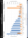
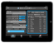









An Enterprise Grade Business Intelligence Platform
Desktop / Laptop
Mobile
Windows
Office
Portals
Browser
BlackBerry
iPhone
iPad
Android
Full Spectrum Of Development Tools
Full Spectrum Of Admin Tools
MicroStrategy
Web
MicroStrategy
Mobile
Web Professional
Enterprise Manager
OLAP
Services
Distribution Services
Report
Services
Transaction
Services
Developer
Command
Manager
MicroStrategy
Intelligence Server
Architect
Object
Manager
SDK
Integrity Manager
System
Manager
Notes:
Source: this slide is from MicroStrategy

Slide 13
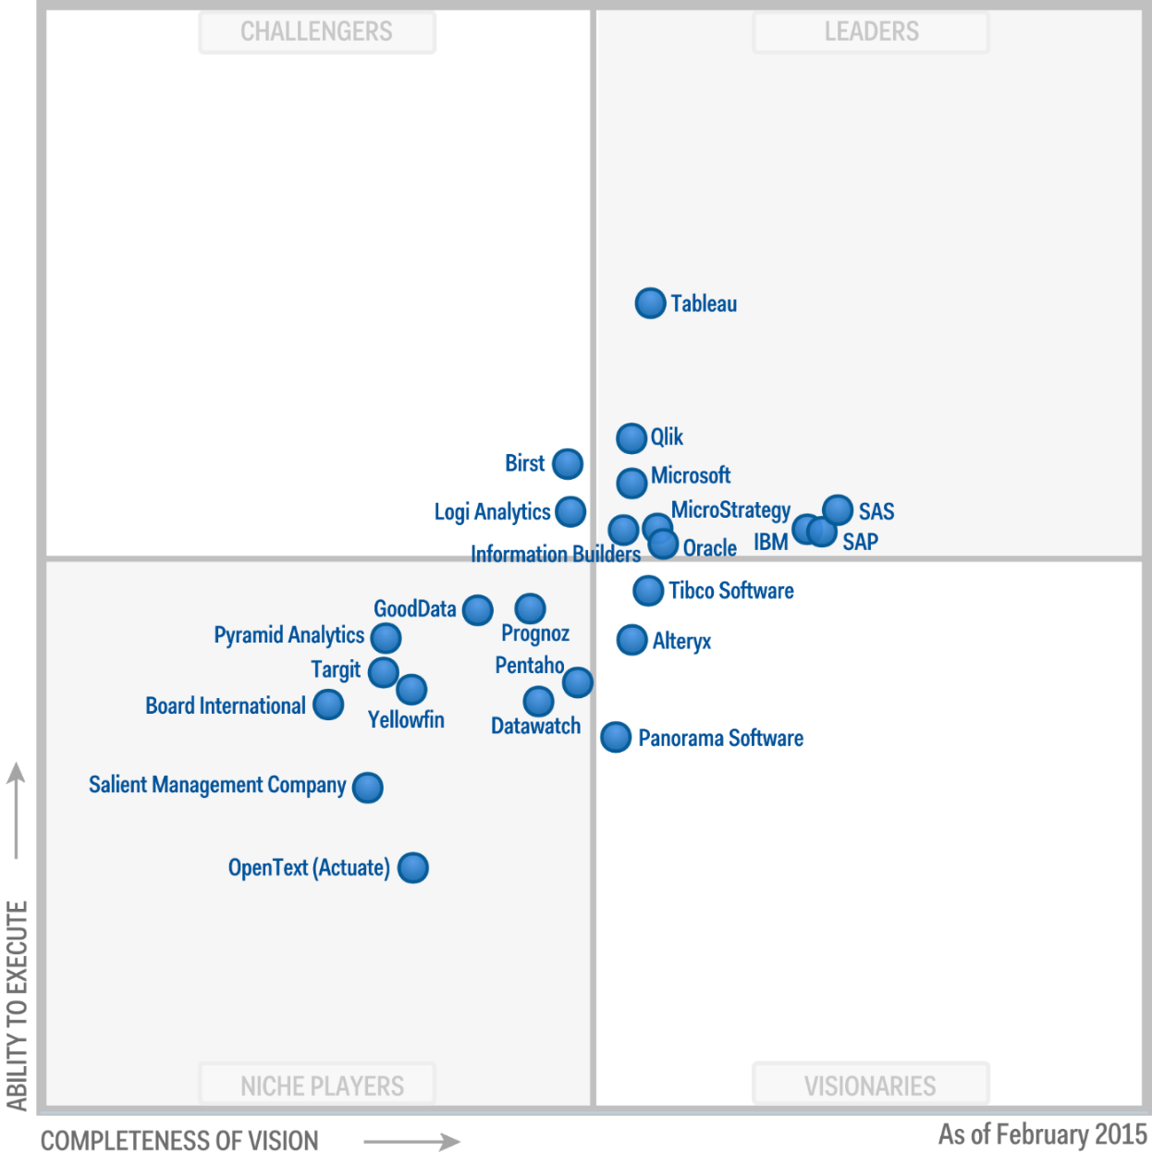
Magic Quadrant for Business Intelligence and Analytics Platforms
Source: Sallam, R. L., Hostmann, B, Schlegel, K., Tapadinhas, J., Parenteau, J., Thomas W. Oestreich, T. W. Magic Quadrant for Business Intelligence Platforms (Links to an external site.) Gartner.com, February 23, 2015
Notes:
Source: Sallam, R. L., Hostmann, B, Schlegel, K., Tapadinhas, J., Parenteau, J., Thomas W. Oestreich, T. W. Magic Quadrant for Business Intelligence Platforms (Links to an external site.) Gartner 23 February 2015
According to Gartner 2015 report, Traditional BI market share leaders are being disrupted by platforms that expand access to analytics and deliver higher business value. The BI and analytics platform market is undergoing a fundamental shift. During the past ten years, BI platform investments have largely been in IT-led consolidation and standardization projects for large-scale systems-of-record reporting. These have tended to be highly governed and centralized, where IT-authored production reports were pushed out to inform a broad array of information consumers and analysts. Now, a wider range of business users are demanding access to interactive styles of analysis and insights from advanced analytics, without requiring them to have IT or data science skills. As demand from business users for pervasive access to data discovery capabilities grows, IT wants to deliver on this requirement without sacrificing governance. This is important for companies as they invest in BI and Analytics platforms. BI leaders should track how traditionalists translate their forward-looking product investments into renewed momentum and an improved customer experience.

Slide 14
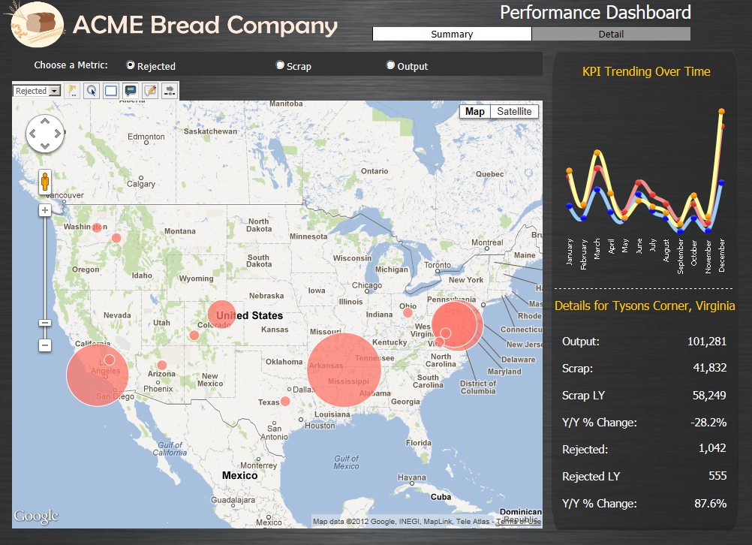
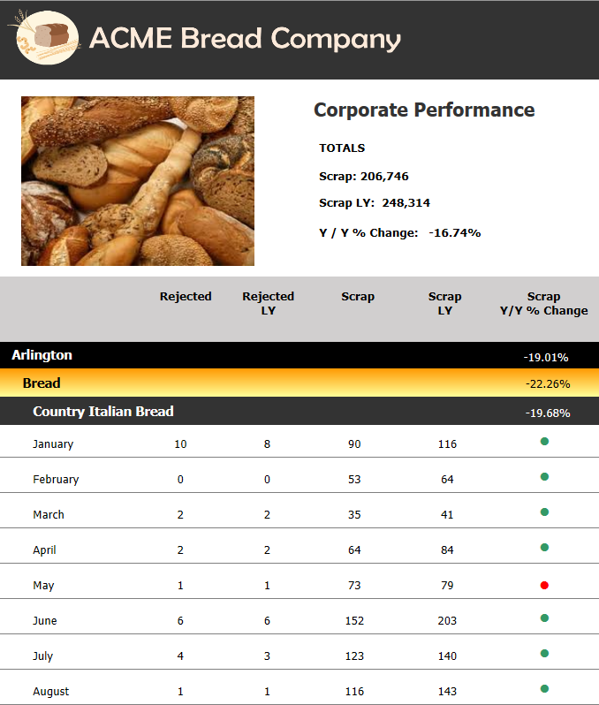
Hands-on Activity #2 Seamless Navigation Across All 7 BI Styles
Dashboards
Advanced Visualizations
Enterprise Reports
OLAP Grid Reports
Custom Analytics
Notes:
Source: this slide is from MicroStrategy

